Slide 1

PV Fed Off-Grid DC-DC Boost Converter for LED Loads.
FIRST REVIEW.
DEPARTMENT OF EEE
IV year -2semester
Academic year: 2020-2021
Presented By:
18985A0208 – A.SAI SAMPATH
18985A0232 – G.CHINNA
18985A0247 – L.RATNAKARA RAO
18985A0271 – Y.VASUDEVA
FACULTY:
Dr.Raja Gopal Peesapati
Associate professor
RAGHU ENGINEERING COLLEGE
(AUTONOMOUS)

Slide 2
Contents.
Particular | Slideno.
Objectives | 3
Significance | 4
Literary Survey | 5-6
Hypothesis | 7
PWM Circuit | 8-13
Waveforms | 14-43
Inductor Design | 44-50
PV-IV Characteristics | 51-52
MATLAB/Simulink Model & Results | 53-54
Scope of Completion | 55

Slide 3
Objectives.
Study of DC-DC boost converters.
To design a MOSFET driver circuit for DC-DC Boost converter.
To design proper inductor for specific load application.
To design a basic conventional DC-DC boost converter circuit.
To integrate the boost converter to PV module.

Slide 4
Significance.
Globally the demand of energy is increasing exponentially. The constant rise in deficit between supply and demand causes concern to the global energy crisis.
Due to rapid improvement in increasing the efficiency and reduction in the manufacturing cost of PV cell, solar energy is becoming more promising source of energy.
Renewable energy system requires a suitable converter, as it generates unregulated power. These systems primarily used boost converter to supply high voltage to the load.

Slide 5
Literary Survey.
Recent years, more attention has been paid to the renewable energy for the increasing cost of fossil fuel and the regulations of CO2 emissions. The output voltage of these energy sources, such as solar panel and fuel cells, is low and variable. Thus, it needs high-ratio DC-DC converter to get the appropriate output voltage.
With the introduction of semiconductor switches in the 1950s, step-up dc–dc converters achieved steady performance advancements and their use accelerated through the 1960s when semiconductor switches became commercially available with allied .manufacturing technologies.

Slide 6
Contd.
A PWM boost converter is a fundamental dc–dc voltage step-up circuit with several features that make it suitable for various applications in products ranging from low-power portable devices to high-power stationary applications.
SINGLE-INDUCTOR multiple-output (SIMO) dc-dc converter provides a compact and low-cost solution for mobile electronic applications that require multiple independent voltage supplies. It reduces the number of off-chip inductors effectively and provides the required independent supply voltages.

Slide 7
Hypothesis.
Study of DC-DC boost converters.
To design a MOSFET driver circuit for DC-DC Boost converter.
To design proper inductor for specific load application.
To design a basic conventional DC-DC boost converter circuit.
To integrate the boost converter to PV module.

Slide 8
PWM Circuit
A NE555 timer was chosen for PWM circuit.
Astable Multivibrator is an oscillating circuit without a stable state i.e., it automatically switches between the two states.
Using just additional components, we can make the 555 Timer to work in Astable Mode.
In Astable Mode, the Capacitor is charging through R1 and R2 while it is discharging only through R2.
Hence, if we replace R2 with a Potentiometer, we can control the charging and discharging tines of the capacitor and essentially the duty cycle of the PWM Signal.
We chose R1 as 10 KΩ resistor, R2 as a 5 KΩ Potentiometer and C1 as 102µF C2 as 103µF.

Slide 9
Complete set up of PWM
Fig.2 PWM circuit diagram

Slide 10
Components Required
555 Timer IC
10 KΩ Resistor
5 KΩ Potentiometer
102µF Capacitor
103µF Capacitor
Breadboard
9V Power Supply
Connecting Wires

Slide 11
Worki.ng of 555 Timer PWM circuit
Now proceeding with working, the capacitor charges through R1and right side of R2 and discharges through left side of R2. So, as we slide the potentiometer’s wiper, we are controlling the charging and discharging times of the capacitor.
Since the charging and discharging of capacitor is directly associated with the ON and OFF duration of the output pulse, we can easily vary the duty cycle of the PWM Signal.

Slide 12
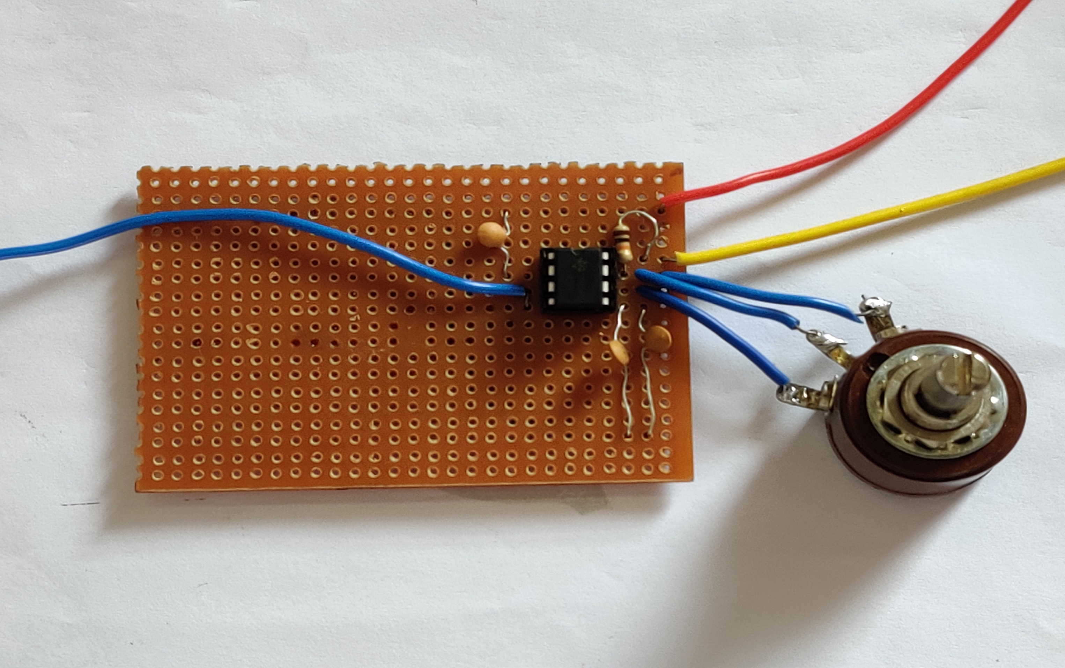
Fig.3(a) Practical PWM Circuit

Slide 13
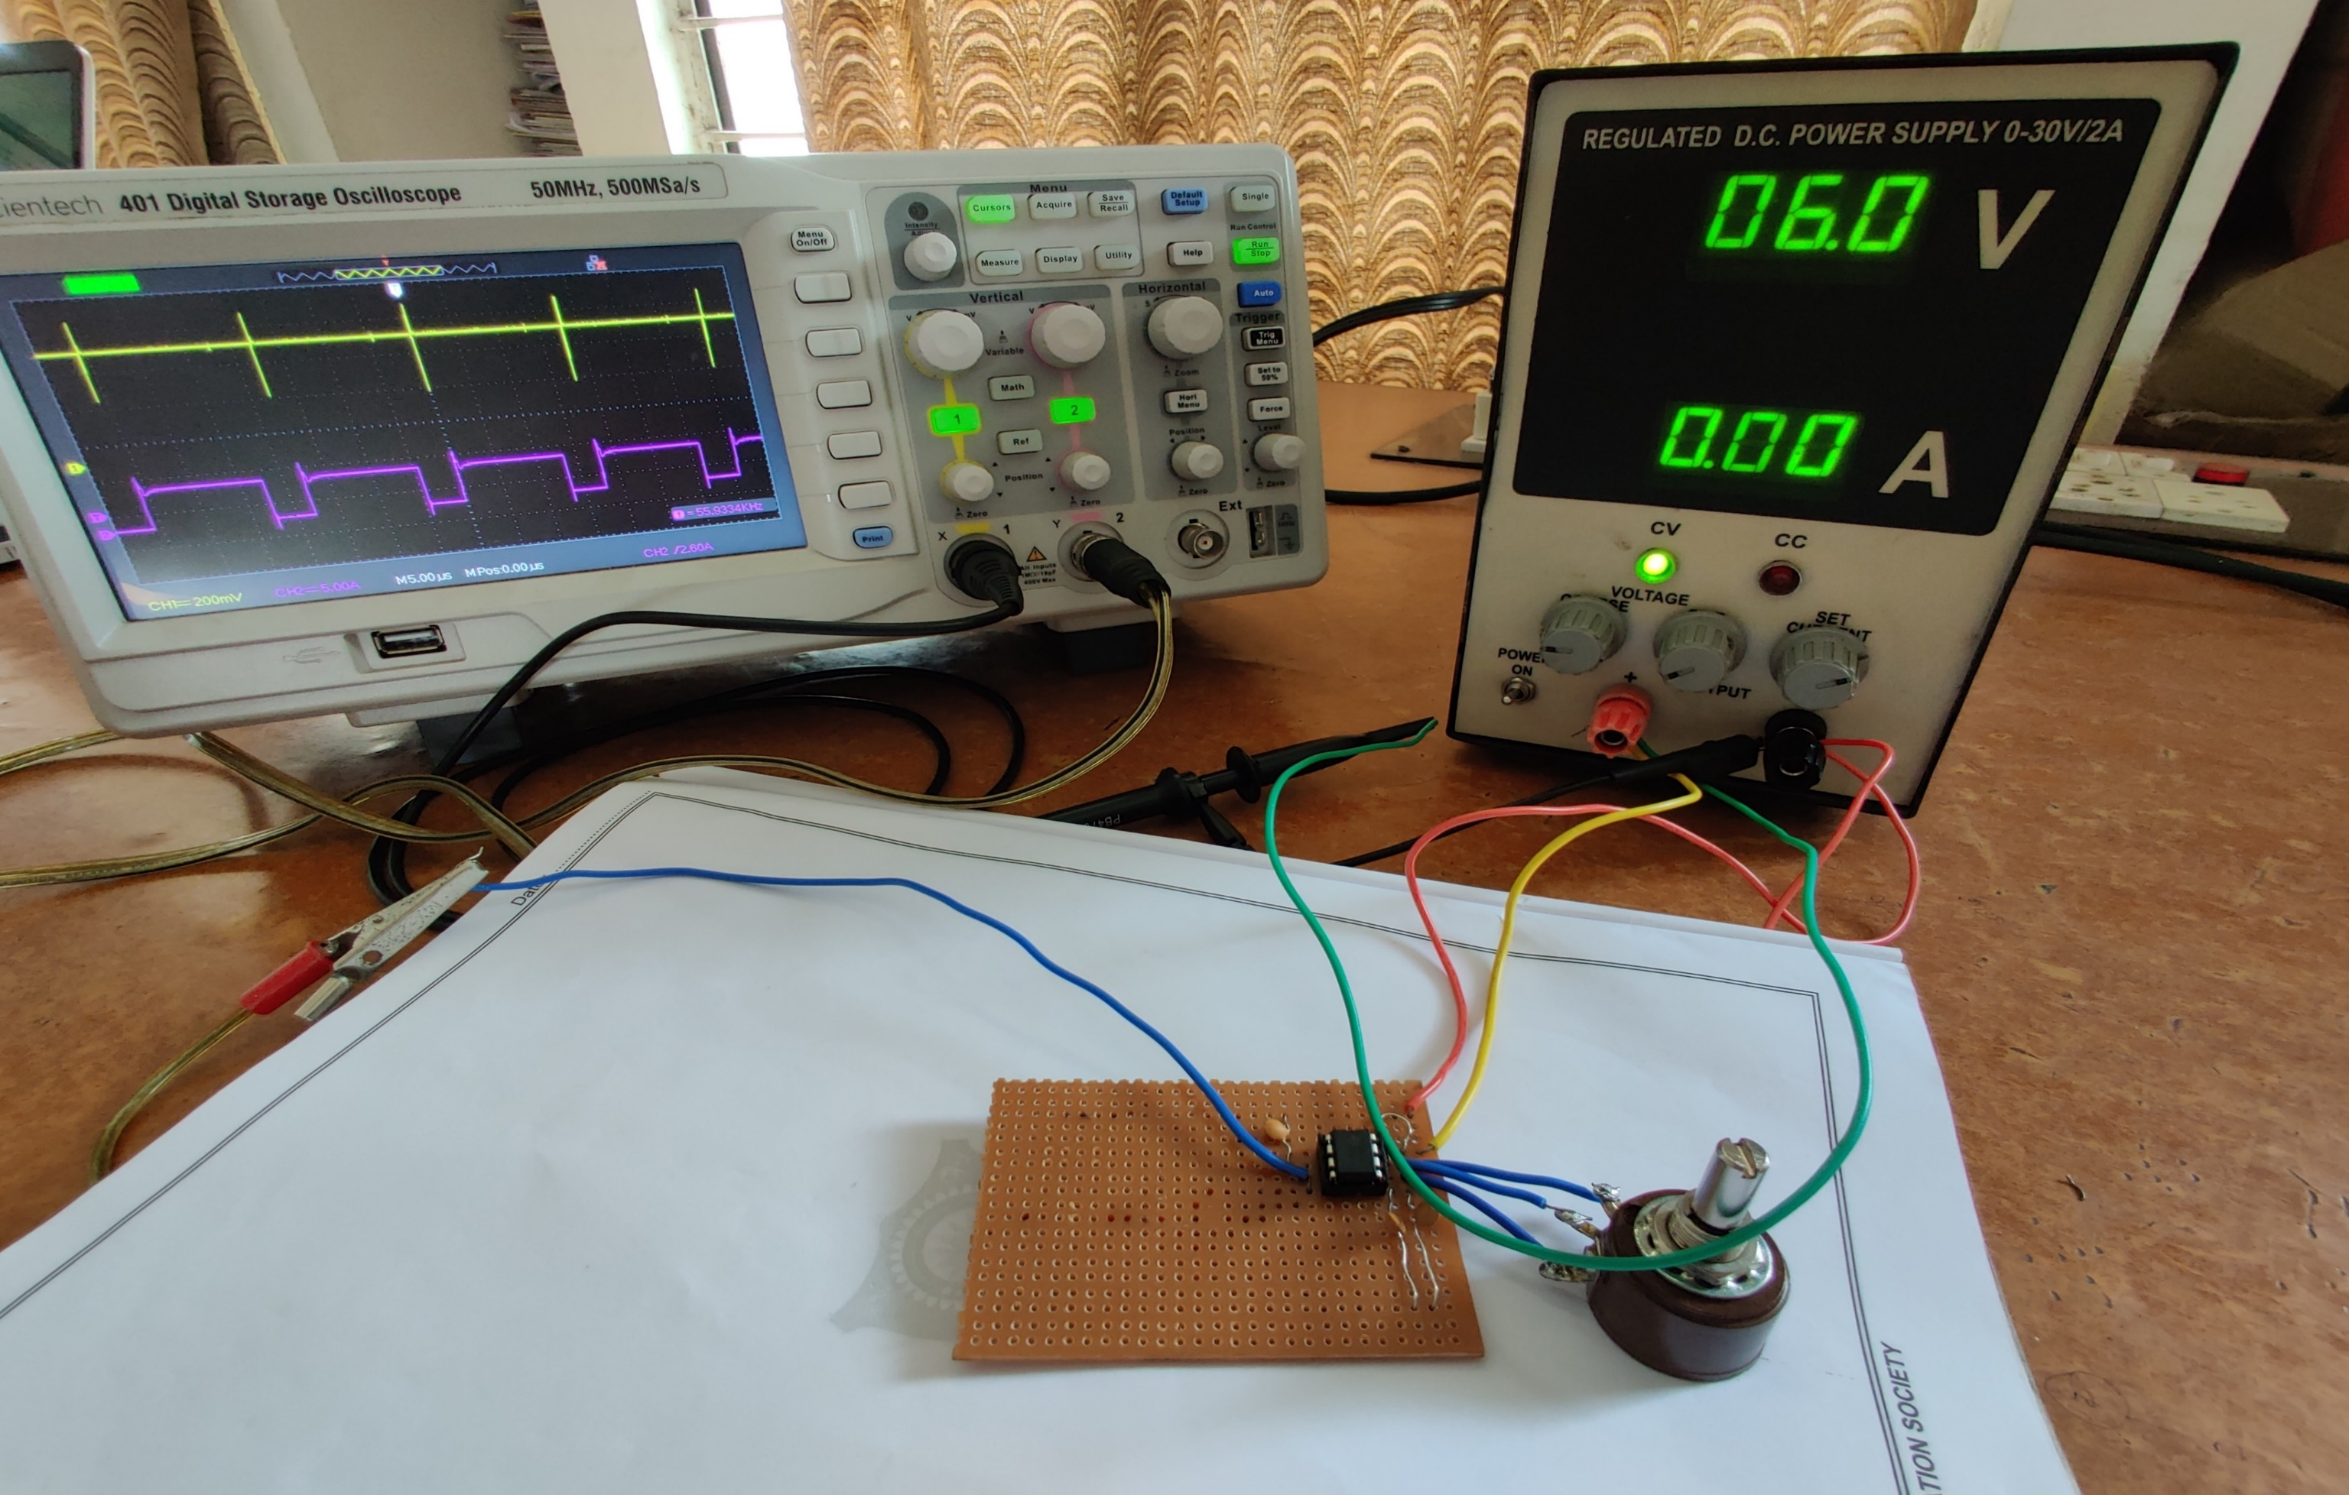
Fig.3(b) Practical PWM Circuit

Slide 14
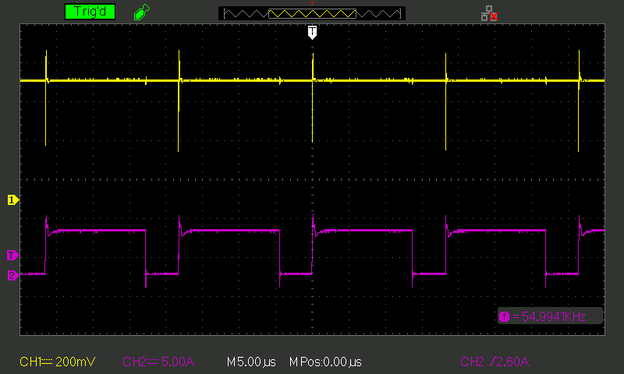
Fig.4. waveform of PMW circuit at duty cycle of 73.5%

Slide 15
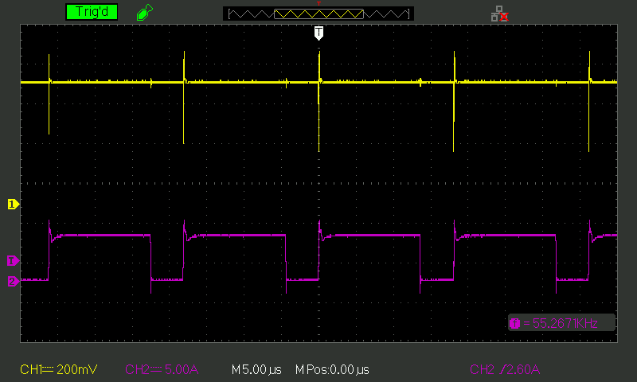
Fig.5. waveform of PMW circuit at duty cycle of 74.1%

Slide 16
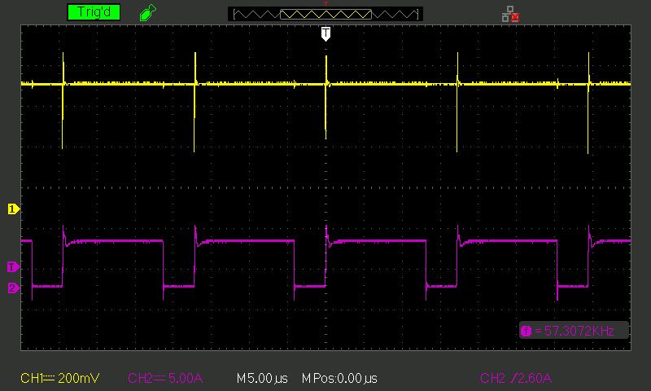
Fig.6. waveform of PMW circuit at duty cycle of 74.9 %

Slide 17
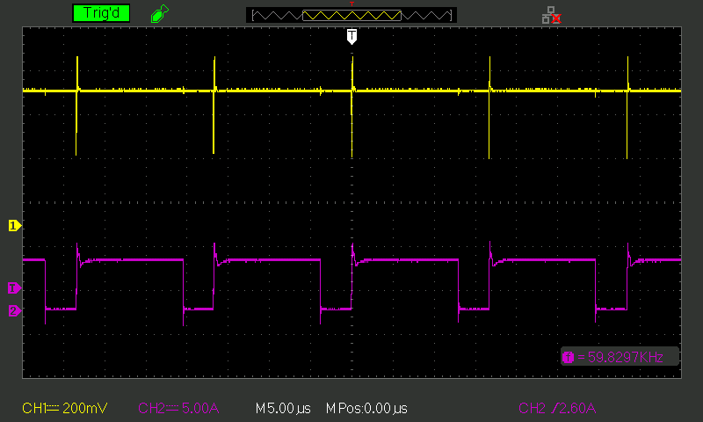
Fig.7. waveform of PMW circuit at duty cycle of 75.6 %

Slide 18
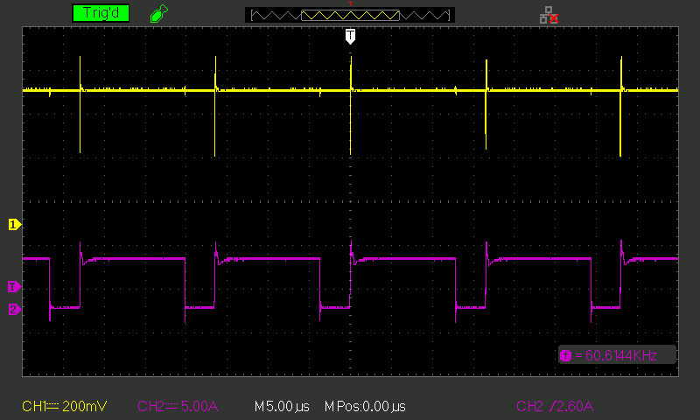
Fig.8. waveform of PMW circuit at duty cycle of 76.2%

Slide 19
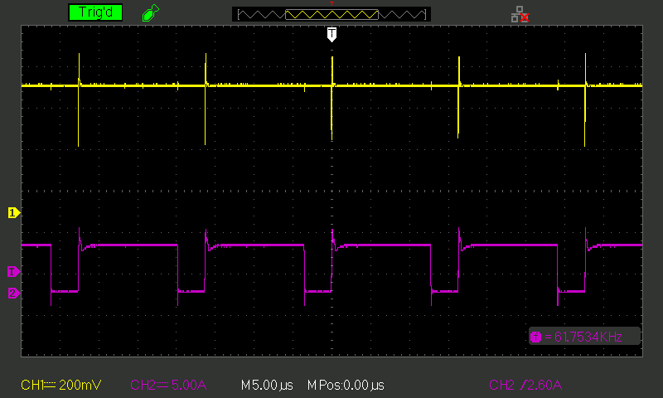
Fig.9. waveform of PMW circuit at duty cycle of 76.9%

Slide 20
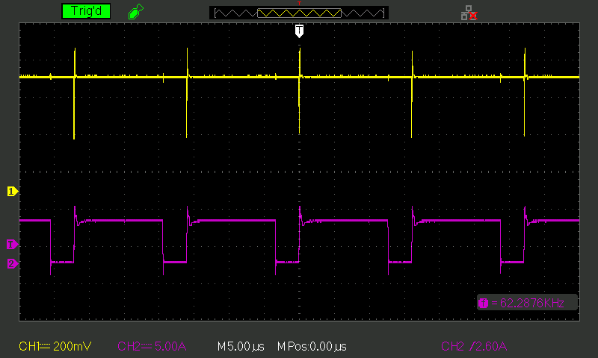
Fig.10. waveform of PMW circuit at duty cycle of 77.4%

Slide 21
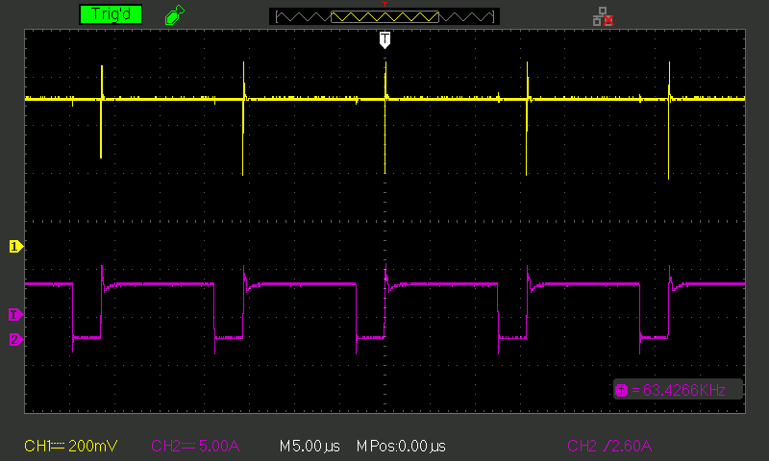
Fig.11. waveform of PMW circuit at duty cycle of 77.9%

Slide 22
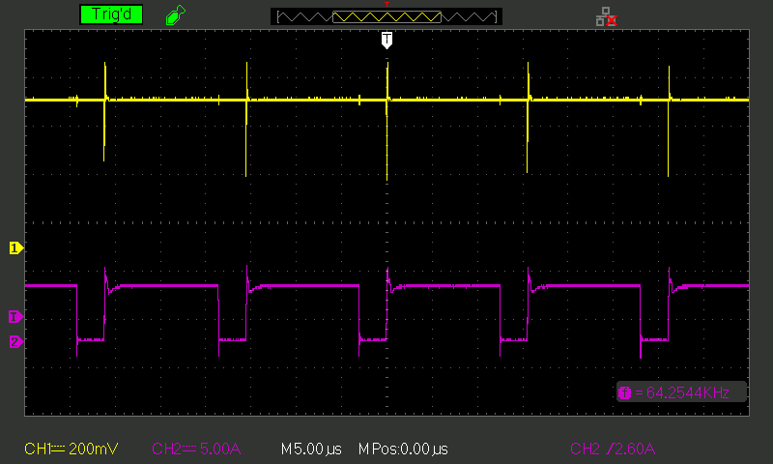
Fig.12. waveform of PMW circuit at duty cycle of 78.7%

Slide 23
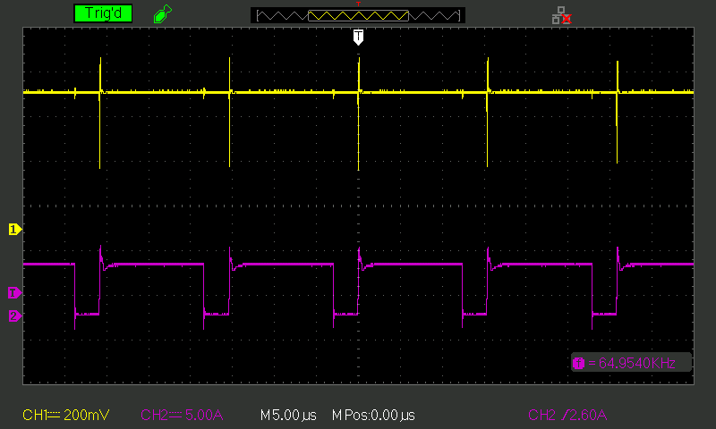
Fig.13. waveform of PMW circuit at duty cycle of 79.2%

Slide 24
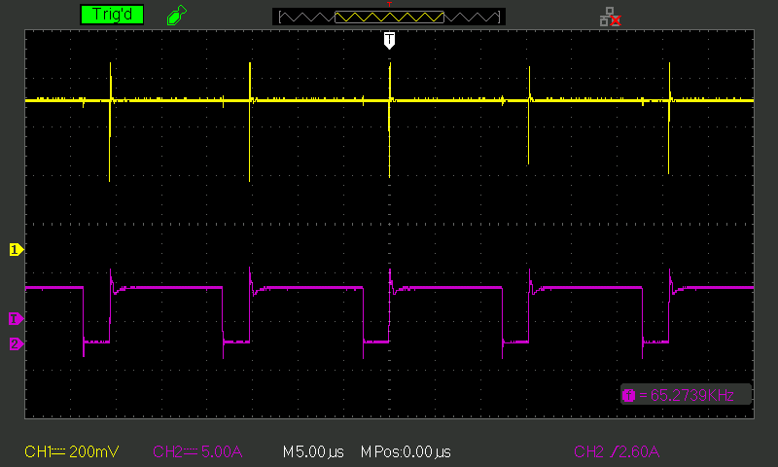
Fig.14. waveform of PMW circuit at duty cycle of 79.8%

Slide 25
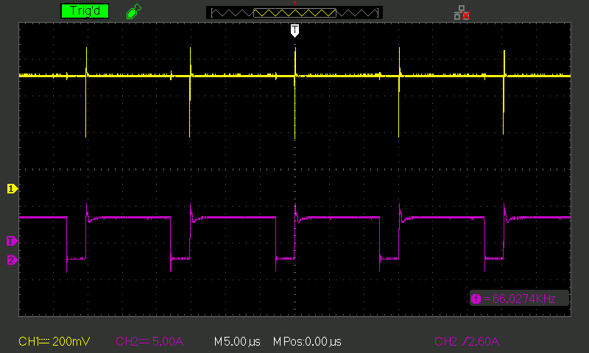
Fig.15. waveform of PMW circuit at duty cycle of 80.2%

Slide 26
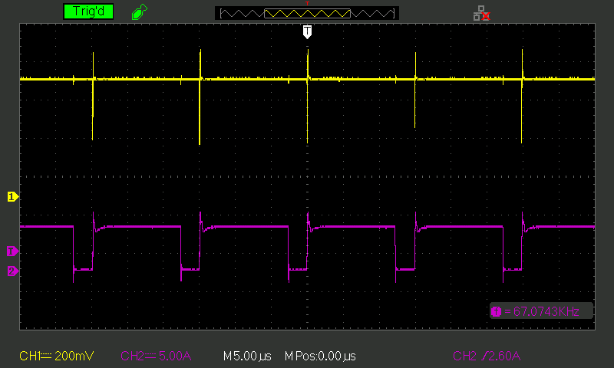
Fig.16. waveform of PMW circuit at duty cycle of 80.9%

Slide 27
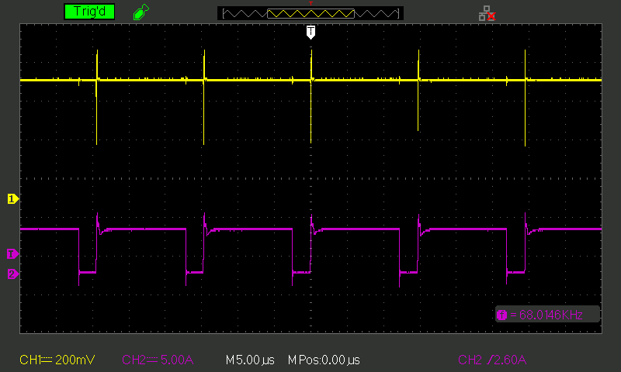
Fig.17. waveform of PMW circuit at duty cycle of 81.4%

Slide 28
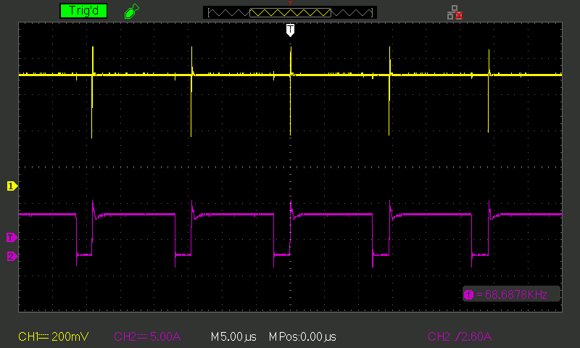
Fig.18. waveform of PMW circuit at duty cycle of 82.4%

Slide 29
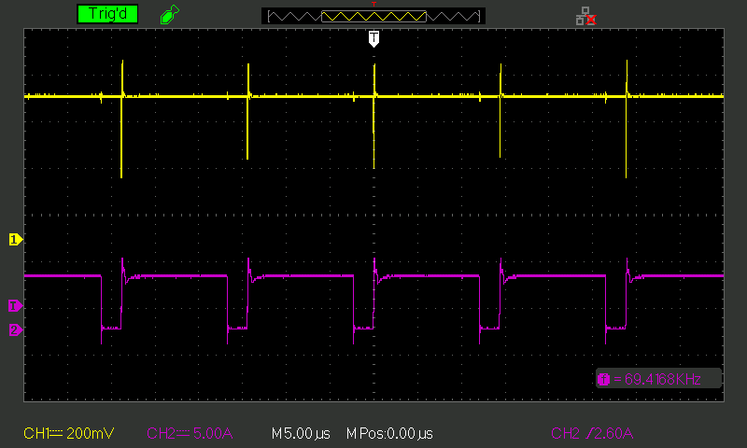
Fig.19. waveform of PMW circuit at duty cycle of 83.6%

Slide 30

Fig.20. waveform of PMW circuit at duty cycle of 84.2%

Slide 31
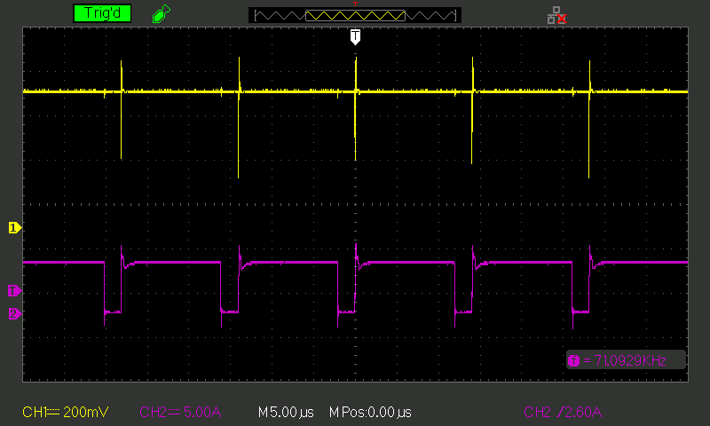
Fig.21. waveform of PMW circuit at duty cycle of 84.9%

Slide 32
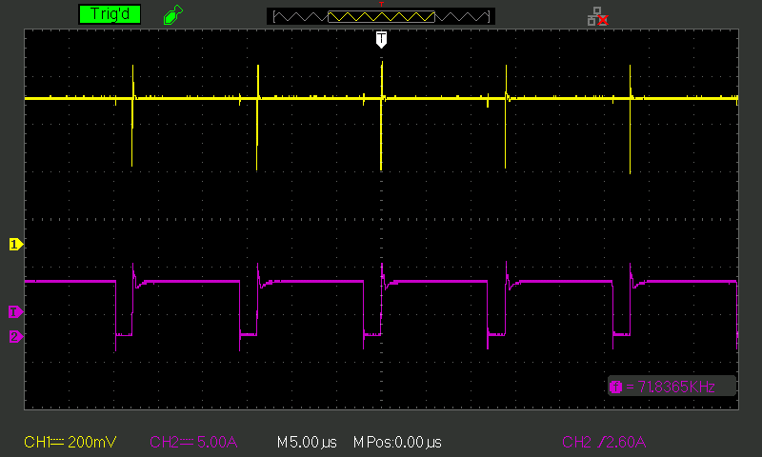
Fig.22. waveform of PMW circuit at duty cycle of 85.3%

Slide 33
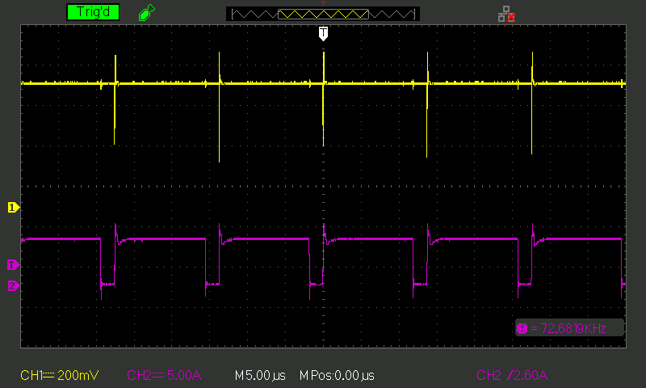
Fig.23. waveform of PMW circuit at duty cycle of 86.1%

Slide 34
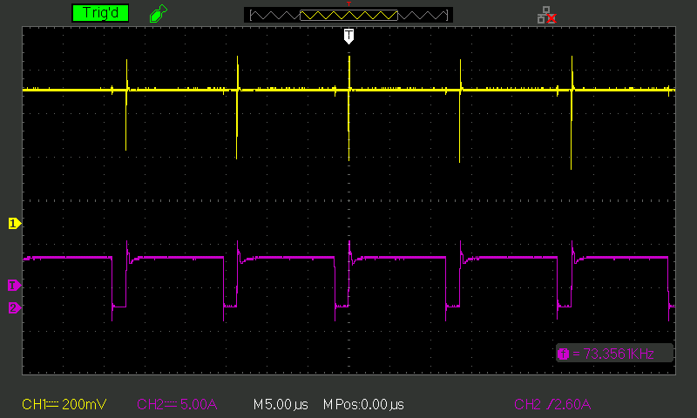
Fig.24. waveform of PMW circuit at duty cycle of 87.2%

Slide 35
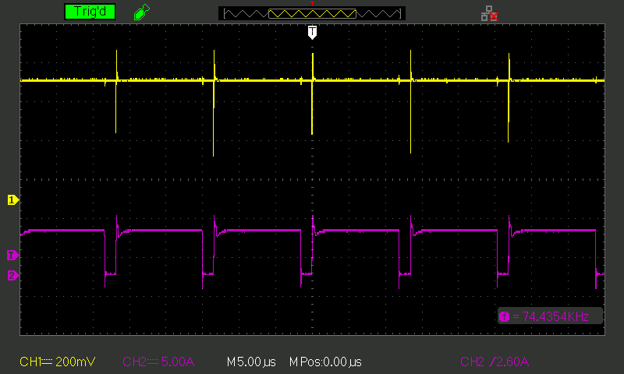
Fig.25. waveform of PMW circuit at duty cycle of 87.8%

Slide 36
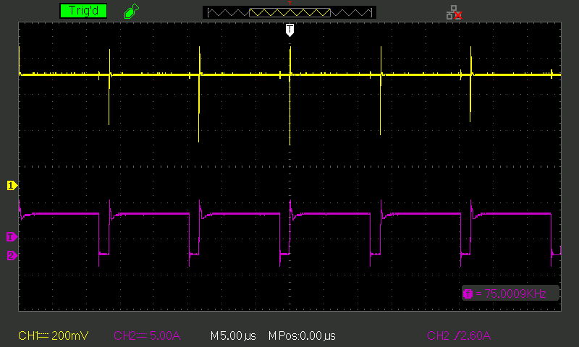
Fig.26. waveform of PMW circuit at duty cycle of 88.3%

Slide 37
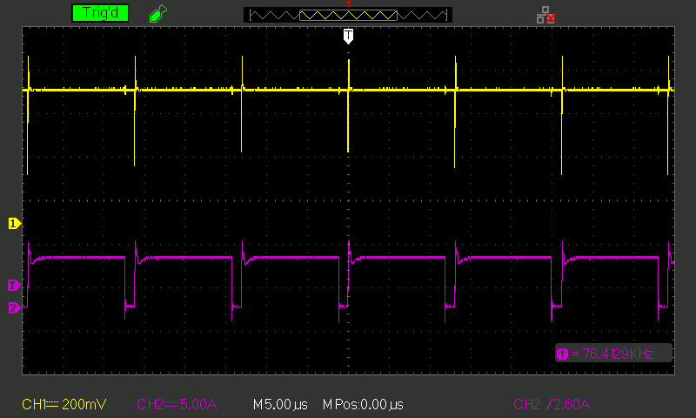
Fig.27. waveform of PMW circuit at duty cycle of 89.2%

Slide 38
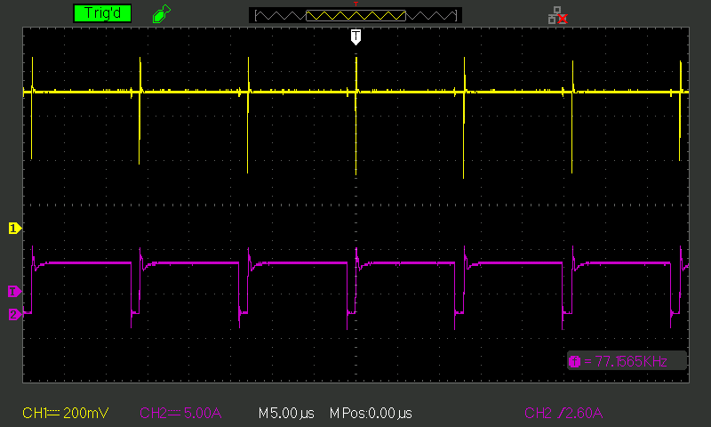
Fig.28. waveform of PMW circuit at duty cycle of 90.3%

Slide 39
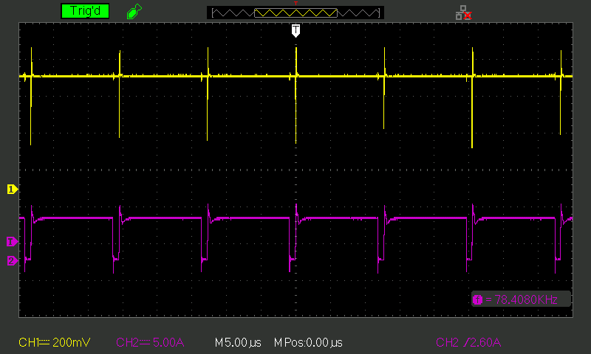
Fig.29. waveform of PMW circuit at duty cycle of 91.2%

Slide 40
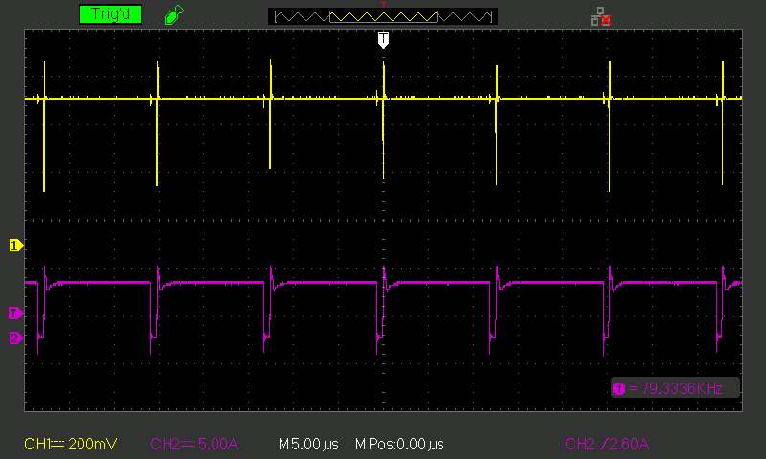
Fig.30. waveform of PMW circuit at duty cycle of 92.9%

Slide 41
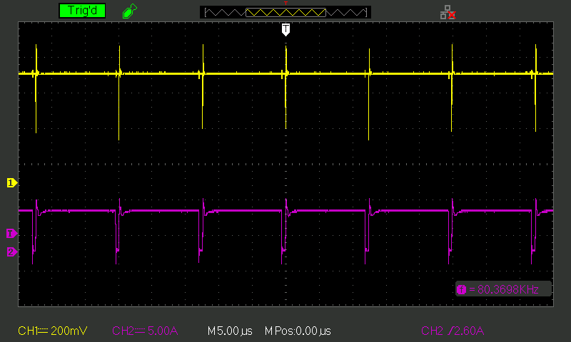
Fig.31. waveform of PMW circuit at duty cycle of 93.5%

Slide 42
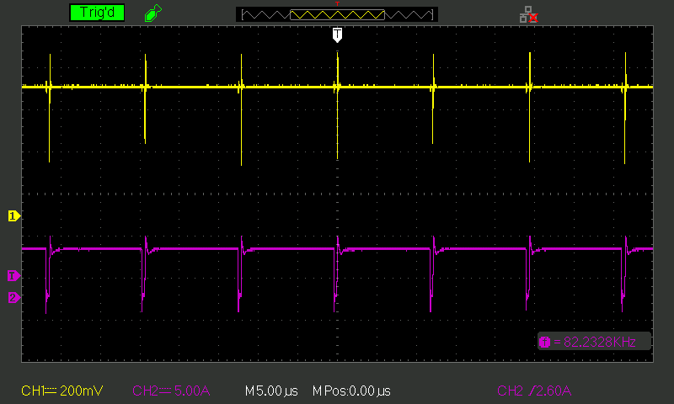
Fig.32. waveform of PMW circuit at duty cycle of 95.4%

Slide 43
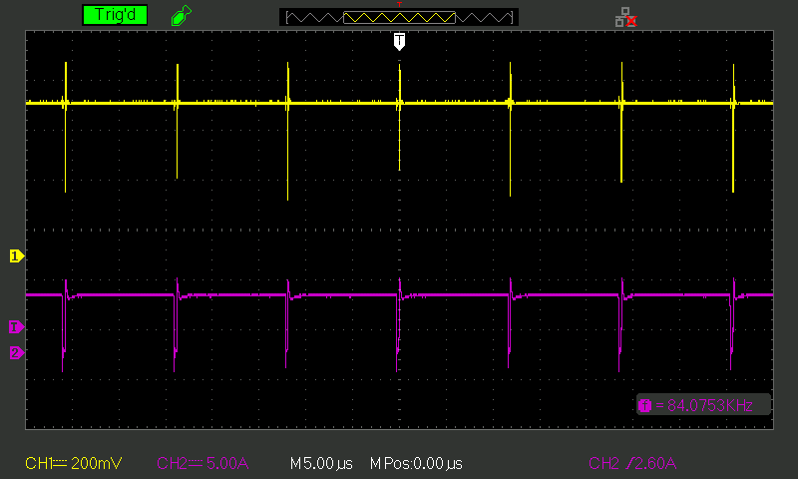
Fig.33. waveform of PMW circuit at duty cycle of 97.2%

Slide 44
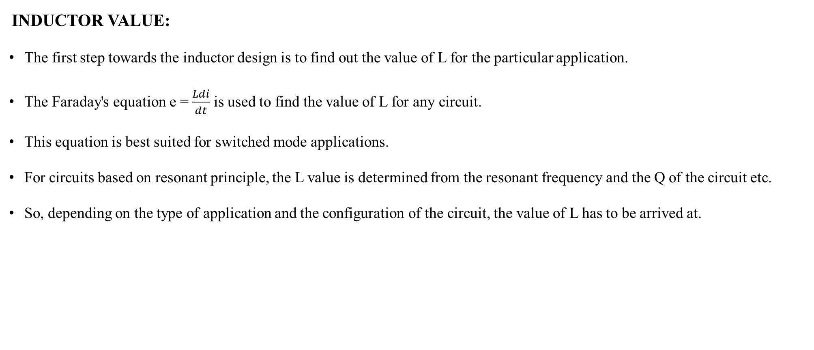
Design of Inductor For Boost Converter.
INDUCTOR VALUE:
The first step towards the inductor design is to find out the value of L for the particular application.
The Faraday's equation e = $\frac{Ldi}{dt}$ is used to find the value of L for any circuit.
This equation is best suited for switched mode applications.
For circuits based on resonant principle, the L value is determined from the resonant frequency and the Q of the circuit etc.
So, depending on the type of application and the configuration of the circuit, the value of L has to be arrived at.

Slide 45
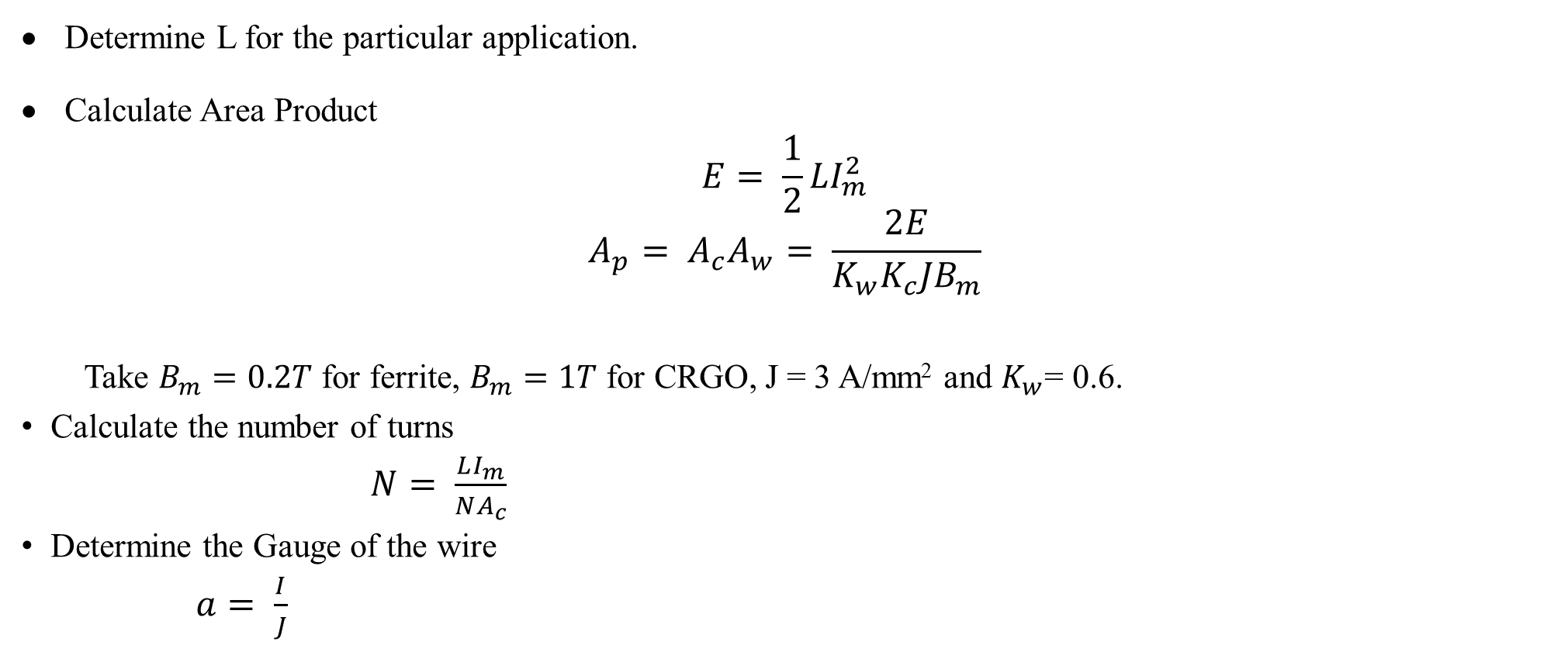
Design Procedure.
Determine L for the particular application.
Calculate Area Product
$$E= \frac{1}{2}LI_{m}^{2}$$
$$A_{p}= A_{c}A_{w}= \frac{2E}{K_{w}K_{c}JB_{m}}$$
Take $B_{m}=0.2T$ for ferrite, $B_{m}=1T$ for CRGO, J = 3 A/mm² and $K_{w}$= 0.6.
Calculate the number of turns
$N= \frac{LI_{m}}{NA_{c}}$
Determine the Gauge of the wire
$a= \frac{I}{J}$

Slide 46
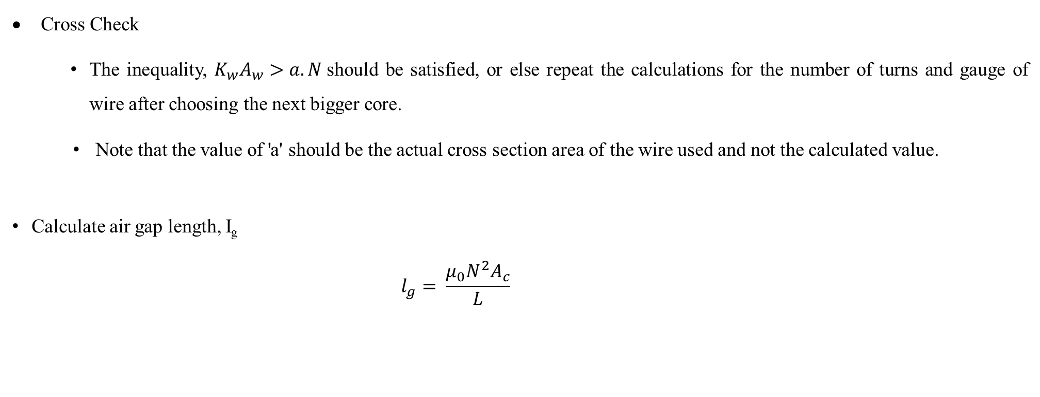
Cross Check
The inequality, $K_{w}A_{w}>a.N$should be satisfied, or else repeat the calculations for the number of turns and gauge of wire after choosing the next bigger core.
Note that the value of 'a' should be the actual cross section area of the wire used and not the calculated value.
Calculate air gap length, I_{g}
$$l_{g}= \frac{μ_{0}N^{2}A_{c}}{L}$$

Slide 47
DETERMINING VALUE OF INDUCTORS FOR SMPCS
In all switched mode converters, the inductor will be used.
When the source is active the voltage V_{AC} is a pulsed waveform with duty cycle D.
When the source is inactive, there exists a freewheeling path in the source side circuit which causes V_{AC} to become zero.
The above configuration applies for forward converter, half bridge, full bridge and push pull converters.
So V_{AB} = V_{AC} - V_{BC}
During the period DT, when the source is active,
V_{AB} = V_{CC} – V_{O} = V_{L}
and during the period (1-D)T, when the source is inactive
V_{AB} = -V_{O}= V_{L} V_{AC}= 0 or V_{BA} = V_{O}

Slide 48
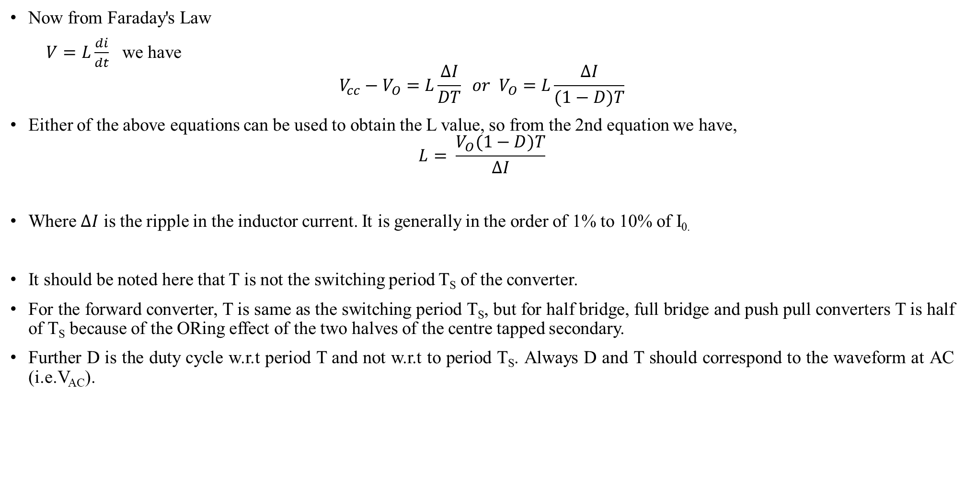
Now from Faraday's Law
$V=L\frac{di}{dt}$ we have
$$V_{cc}−V_{O}=L\frac{∆I}{DT} or V_{O}=L\frac{∆I}{(1−D)T}$$
Either of the above equations can be used to obtain the L value, so from the 2nd equation we have,
$$L= \frac{V_{O}(1−D)T}{∆I}$$
Where $∆I$ is the ripple in the inductor current. It is generally in the order of 1% to 10% of I_{0.}
It should be noted here that T is not the switching period T_{S} of the converter.
For the forward converter, T is same as the switching period T_{S}, but for half bridge, full bridge and push pull converters T is half of T_{S} because of the ORing effect of the two halves of the centre tapped secondary.
Further D is the duty cycle w.r.t period T and not w.r.t to period T_{S}. Always D and T should correspond to the waveform at AC (i.e.V_{AC}).

Slide 49
Physical, Electrical and Magnetic Characteristics of Toroidal Ferric Cores.
CORES Without air gap | Mean length per turn I_{c} mm | Mean ma gnetic length I_{n} mm | Core cross section area A_{c} ×100 mm² | Window area Aw×100 mm² | Area product Ap×104 mm⁴ | Effective relative permeabilityµ_{r}±25% | AL nH/turns²±25%
T 10 | 12.8 | 23.55 | 0.062 | 0.196 | 0.012 | 2300 | 765
T 12 | 19.2 | 30.40 | 0.12 | 0.442 | 0.053 | 2300 | 1180
T 16 | 24.2 | 38.70 | 0.20 | 0.785 | 0.157 | 2300 | 1482
T 20 | 25.2 | 47.30 | 0.22 | 0.950 | 0.213 | 2300 | 1130
T 27 | 34.1 | 65.94 | 0.42 | 1.651 | 0.698 | 2300 | 1851
T 32 | 39.6 | 73.00 | 0.61 | 1.651 | 1.010 | 2300 | 2427
T 45 | 54.7 | 114.50 | 0.93 | 6.157 | 5.756 | 2300 | 2367

Slide 50
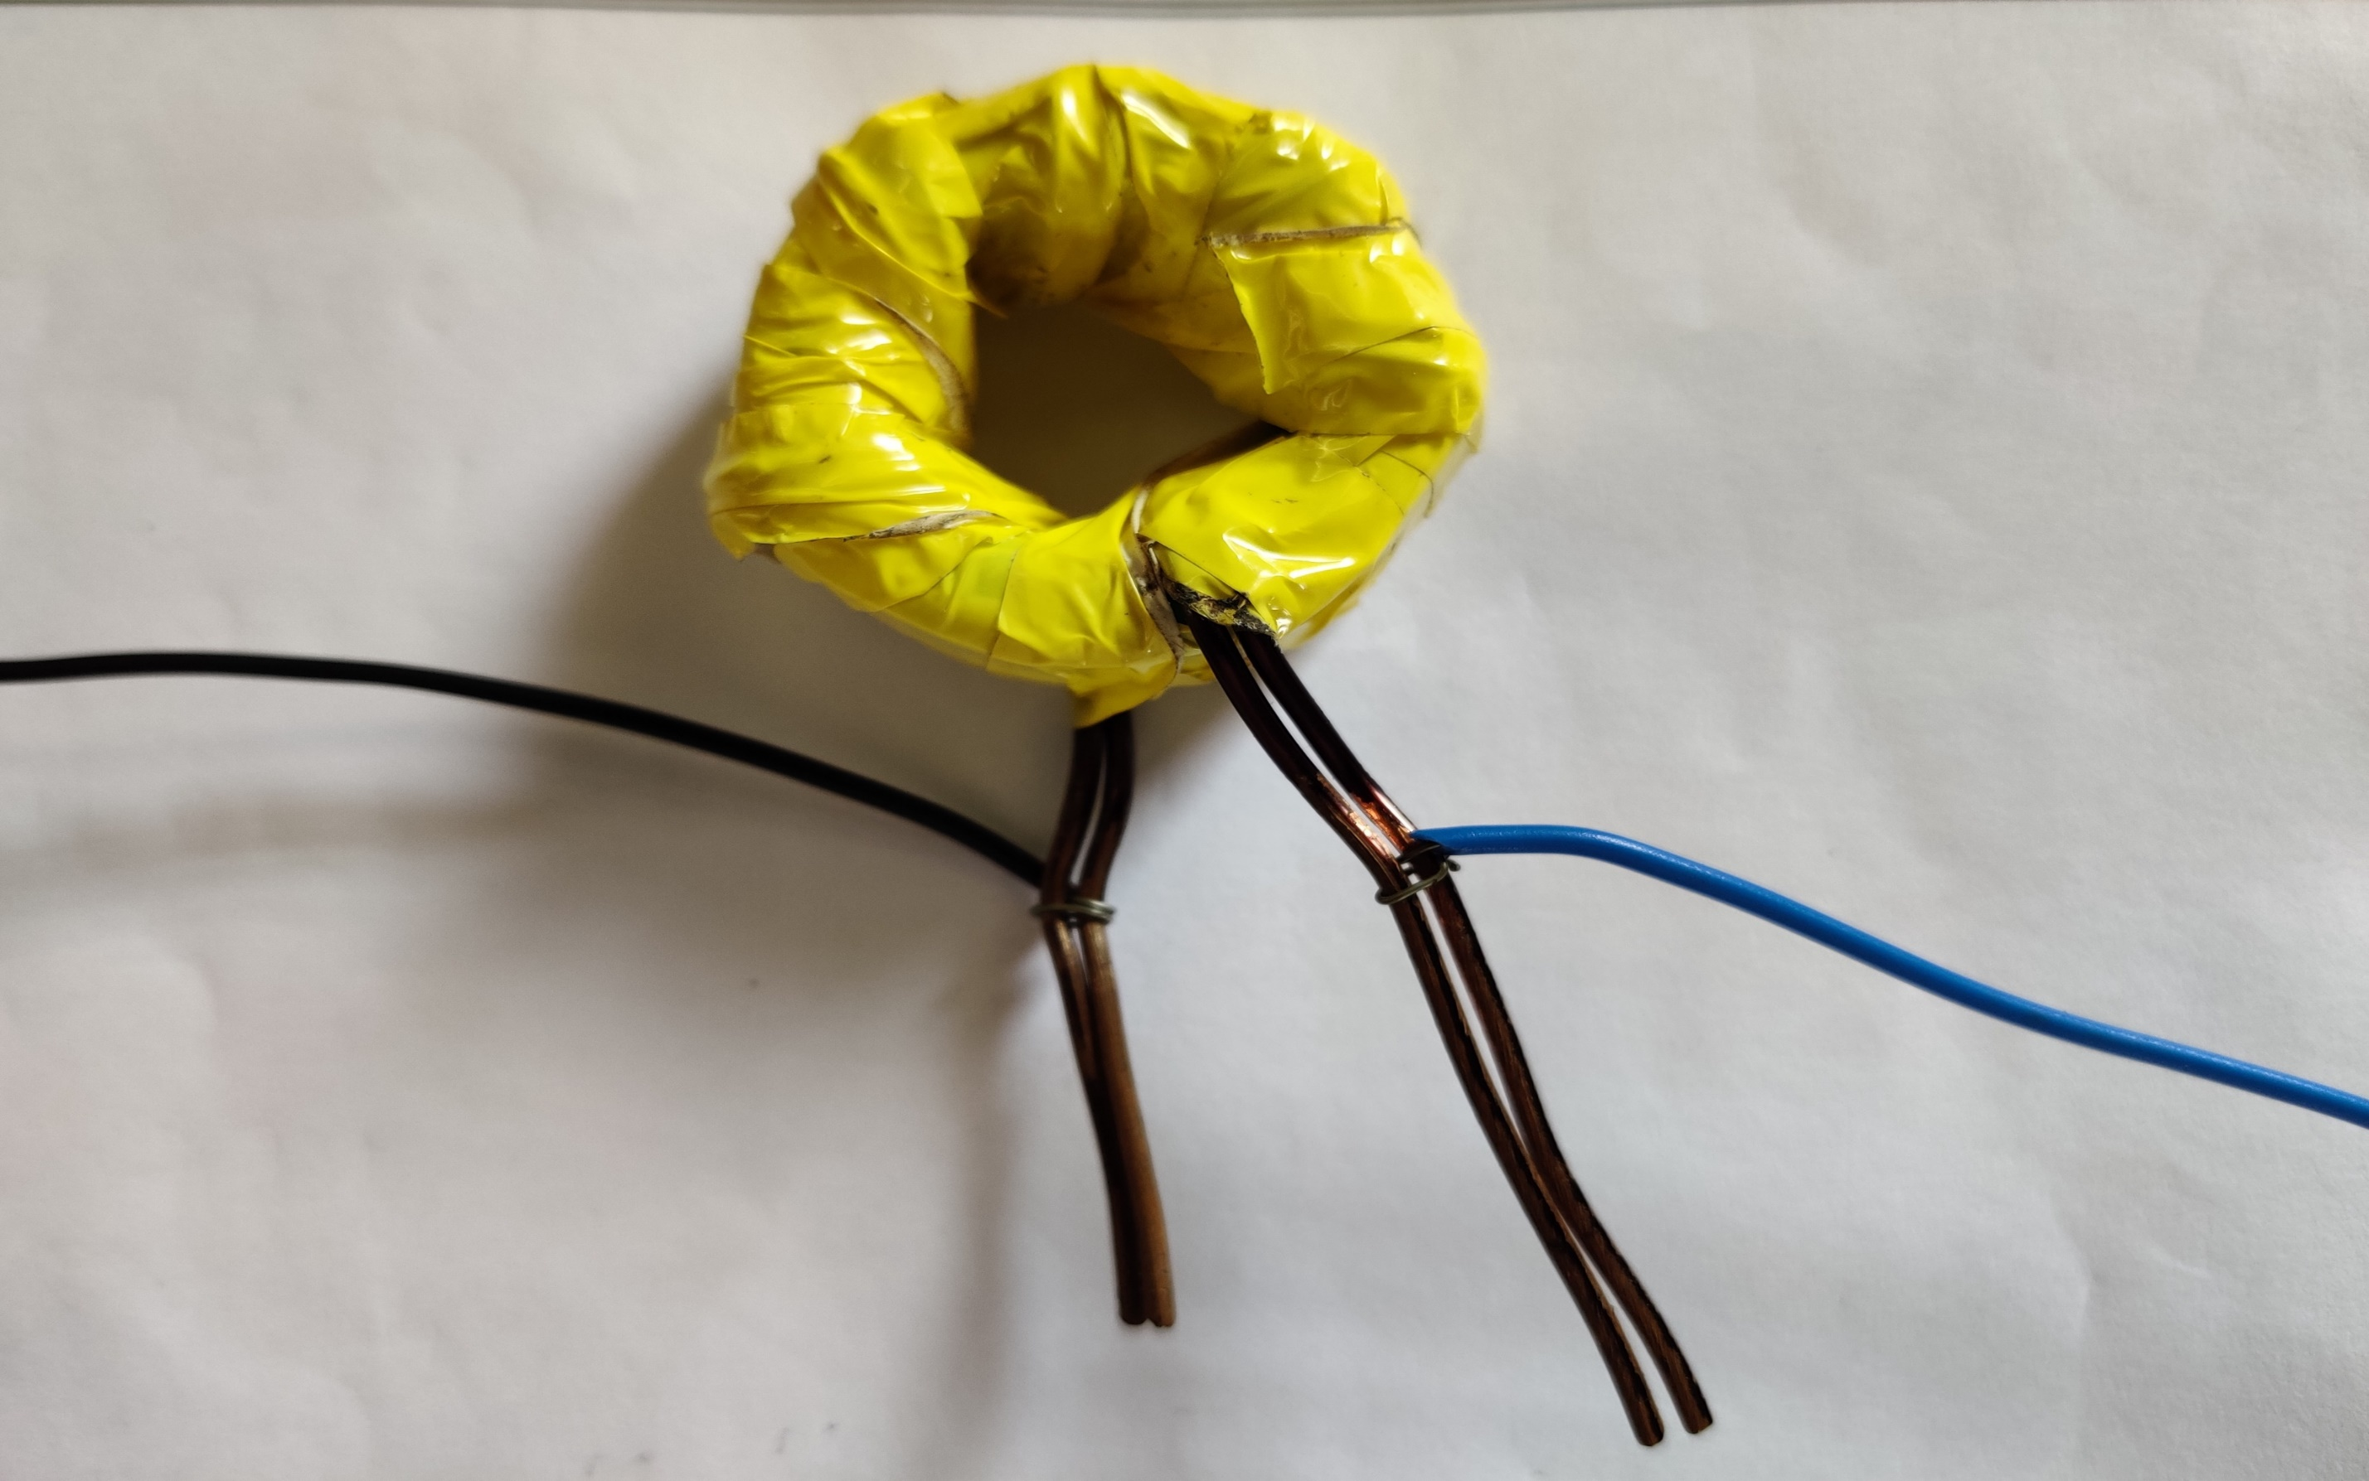
Fig.34. Toroidal Core Inductor of 0.125 mH with 34 turns

Slide 51
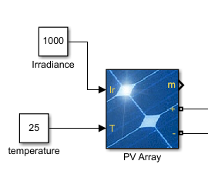
PV ARRAY
Fig.35. Simulink PV array

Slide 52
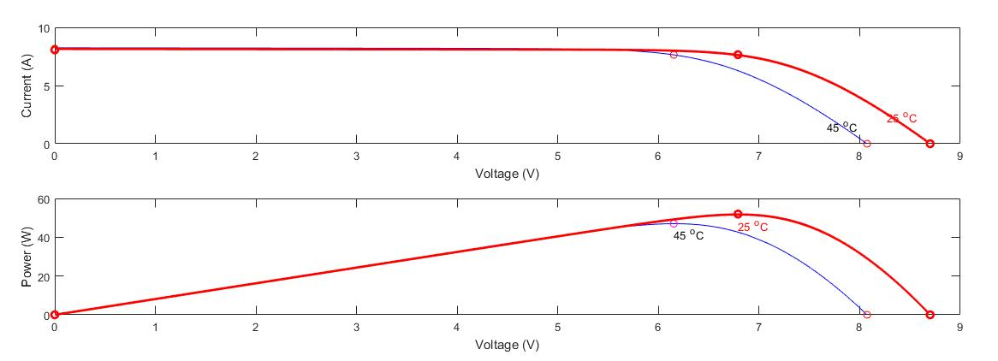
PV-IV Characteristics of PV Panel.

Slide 53
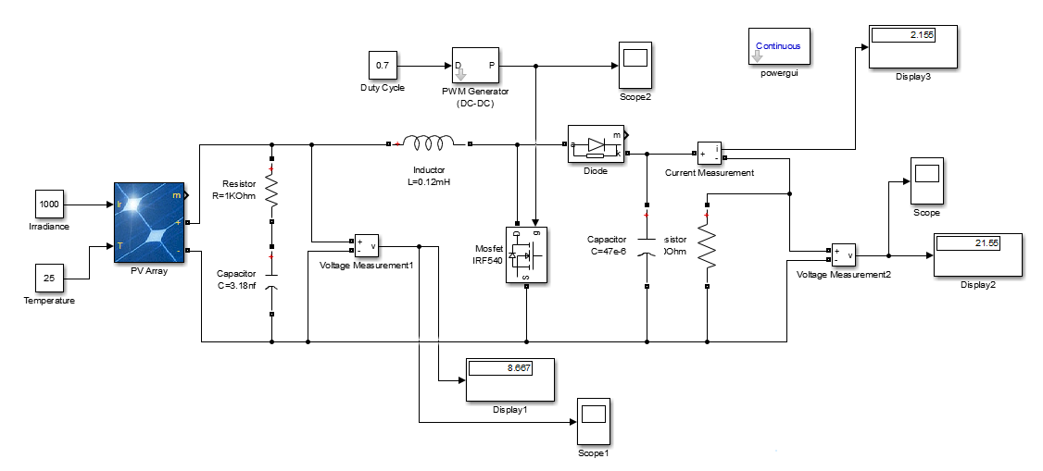
MATLAB/Simulink Model .

Slide 54
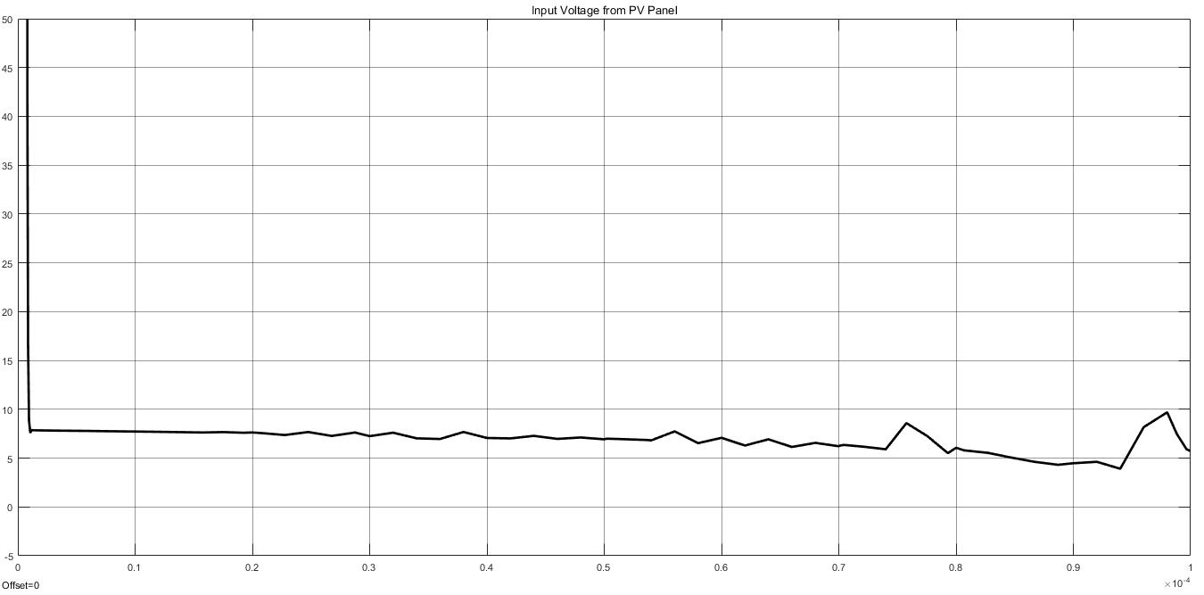
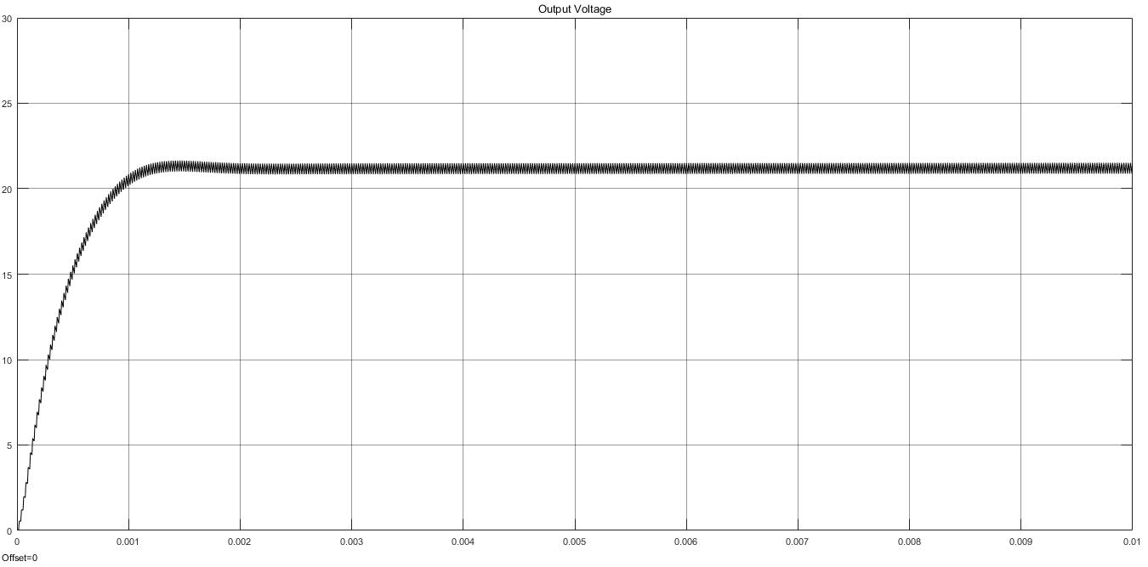
Results.
Input Voltage
Output Voltage

Slide 55
Scope Of Completion.
Owing to the pandemic we could not complete the hardware model which was proposed earlier, complete Simulink model of the same was designed. A few tweaks in the design should give us the desired results.
The thesis part of work is under process and will be completed by next review.

Slide 56
References.
Guanlin Li, Xin Jin, Xiyou Chen, and Xianmin Mu, “A Novel Quadratic Boost Converter With Low Inductor Currents” in IEEEJ CPSS.
Yanqi Zheng, Jianping Guo, Senior Member, IEEE, and Ka Nang Leung, Senior Member, IEEE, “A Single-Inductor Multiple-Output Buck/Boost DC-DC Converter With Duty-Cycle and Control-Current Predictor.”
Mojtaba Forouzesh, Student Member, IEEE, Yam P. Siwakoti, Member, IEEE, Saman A. Gorji, Student Member, IEEE, Frede Blaabjerg, Fellow, IEEE, and Brad Lehman, Senior Member, IEEE, “Step-Up DC–DC Converters: A Comprehensive Review of Voltage-Boosting Techniques, Topologies, and Applications.”

Slide 57
THANK YOU..

